Slide 1

Warehouse Drone Collision Avoidance
STG2 final presentation by Tristan van Vegchel
27-01-2020

Slide 2
Agenda
Context
Project Description
Approaches
Prototypes
Conclusion & Demo

Slide 3
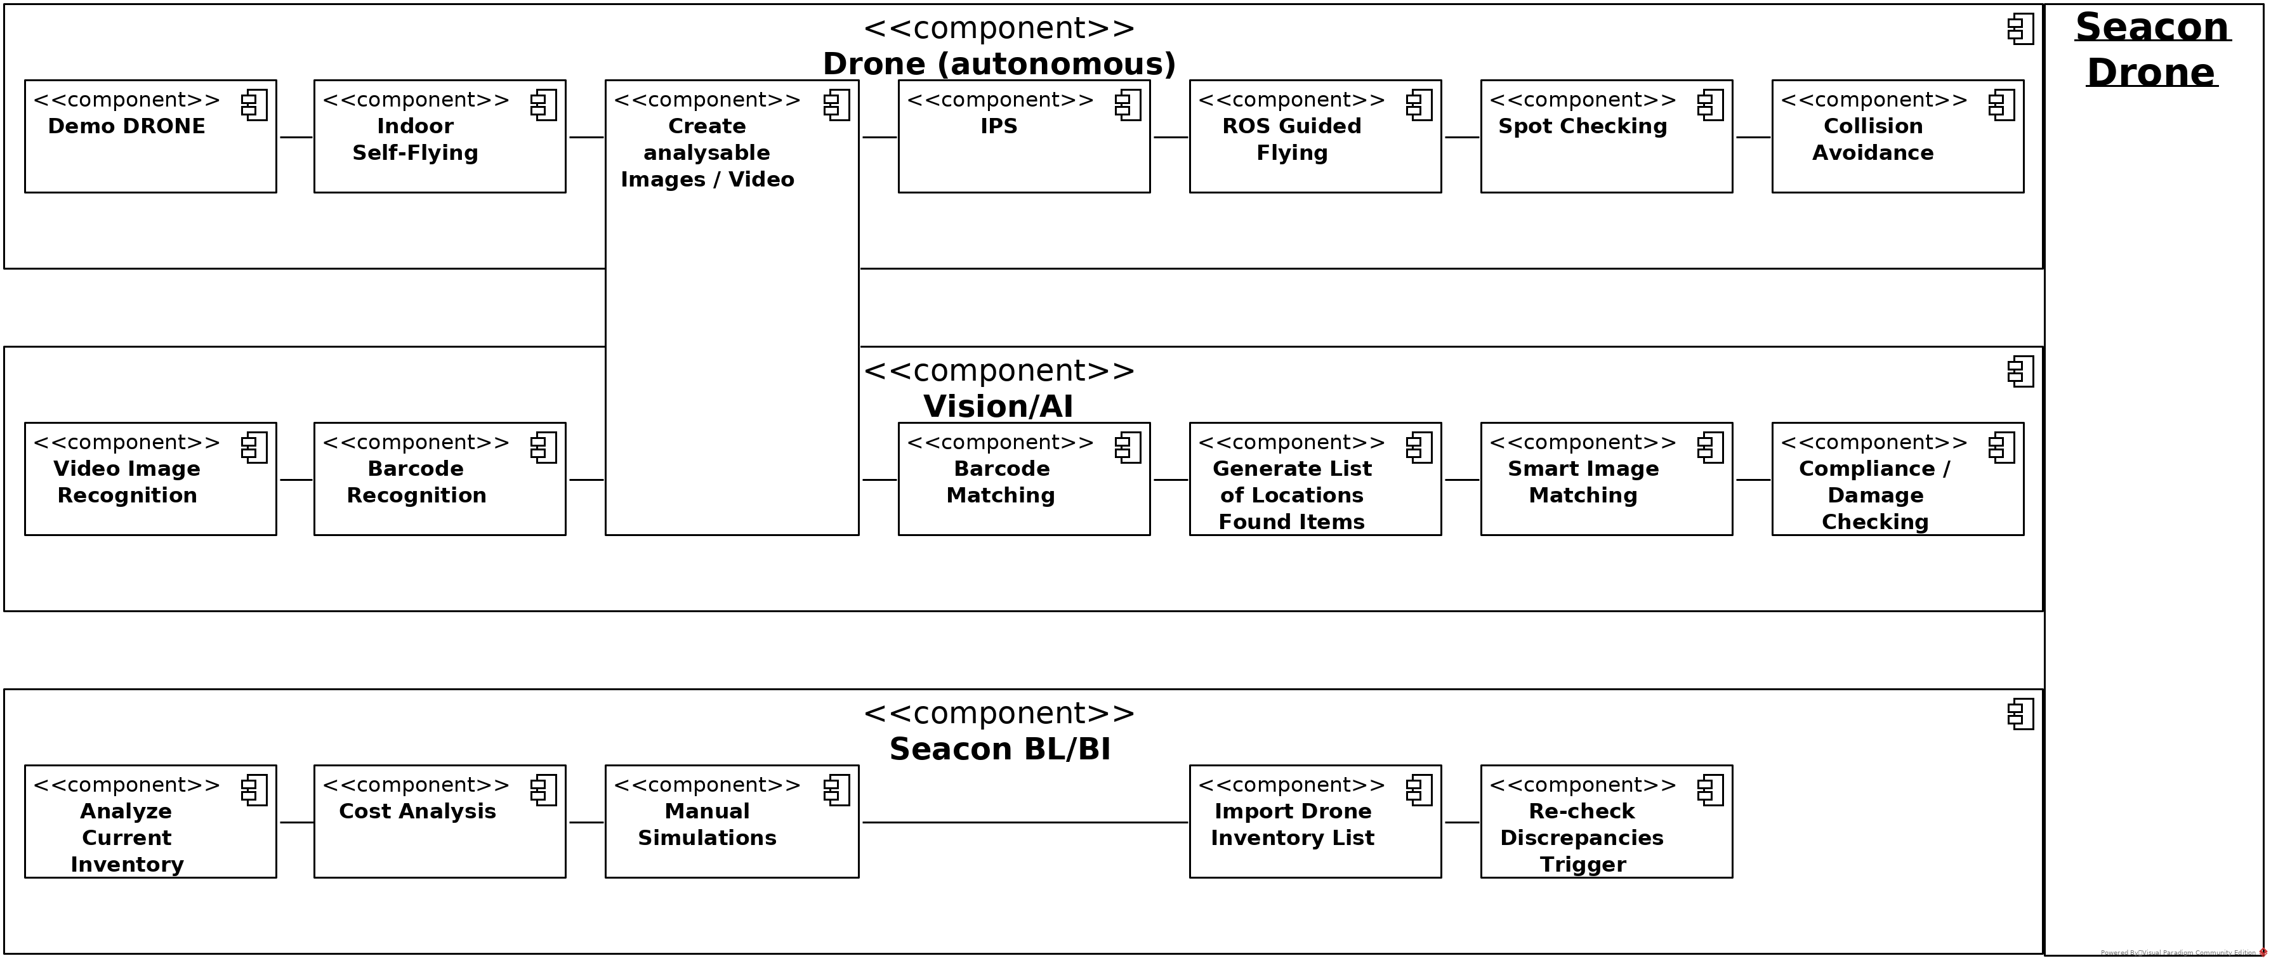
Context
Notes:
Keep intro Seacon minimal
Reasons for project: expensive, perfect picking is difficult

Slide 4
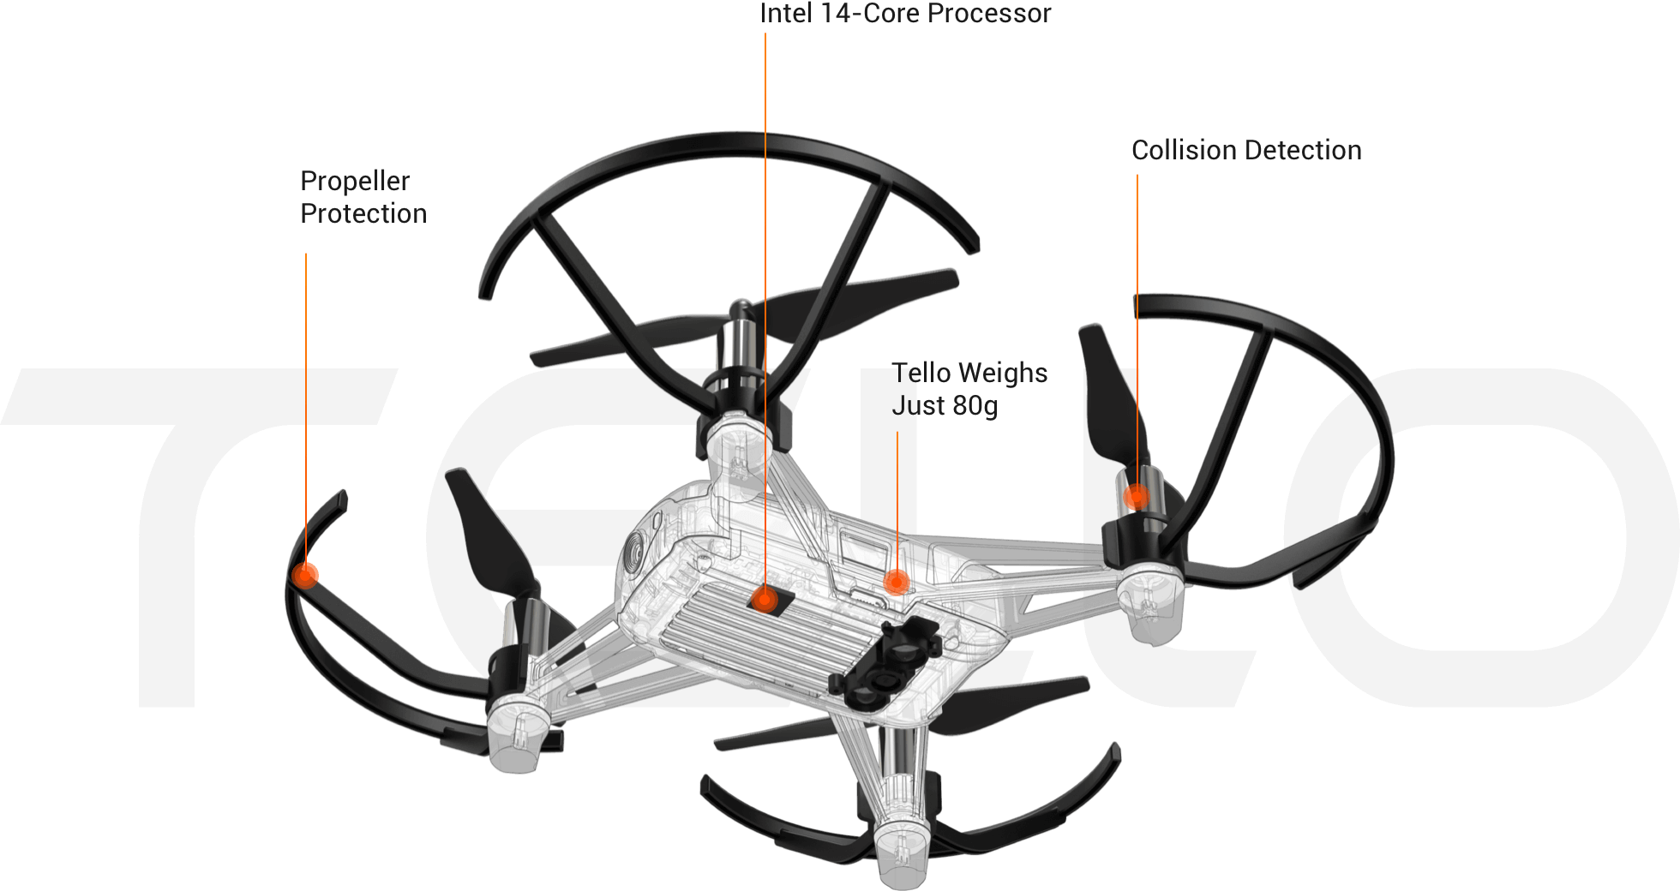
Project Description
Environment
Racks
Pallets
People
Forklifts
Drones
Notes:
Why Tello

Slide 5
Agenda
Context
Project Description
Approaches
Prototypes
Conclusion & Demo

Slide 6
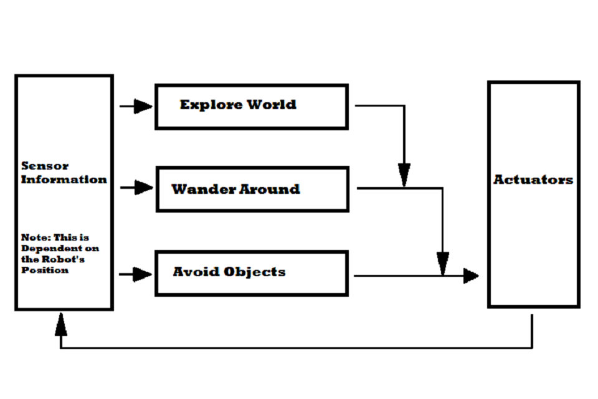
DQN Subsumption Architecture
Signal suppression
Multi-Objective DQN
Notes:
Multi objective DQN using visual input
Signal suppression

Slide 7
Object Detection
Mask R-CNN
Pixel/size ratio

Slide 8
Machine Learning Agents
Standard implementations
Connects Python to Unity
RL, IL, CL
Notes:
Has standard RL, IL, CL
Refer to image

Slide 9
Agenda
Context
Project Description
Approaches
Prototypes
Conclusion & Demo

Slide 10
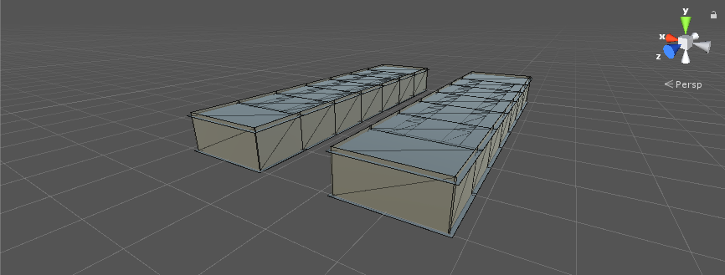
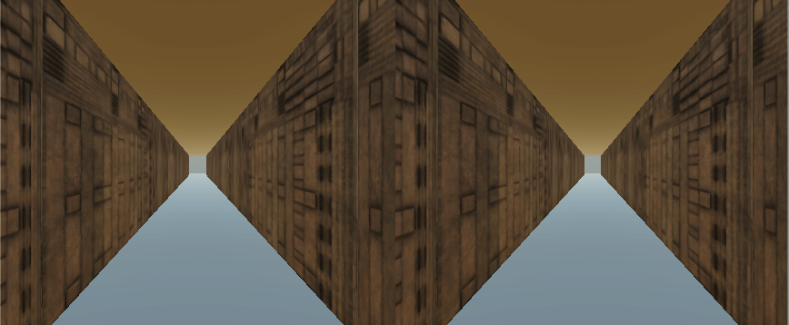
ML-Agents: Simulation

Slide 11
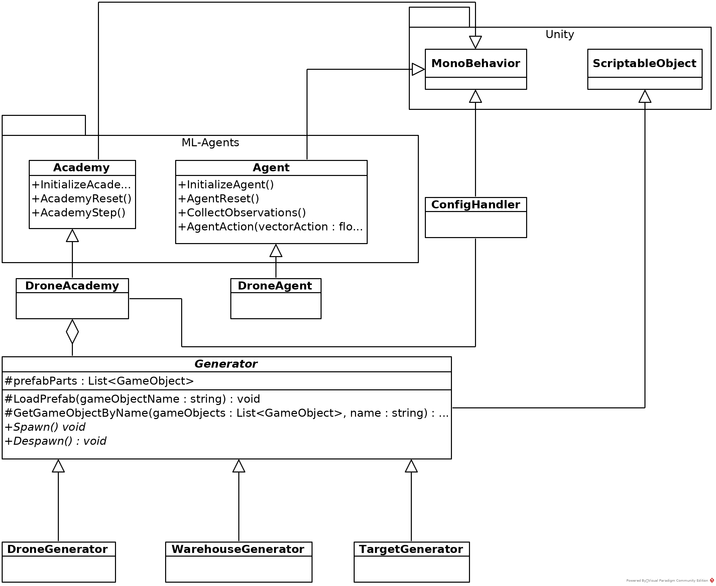
Notes:
Only explain how it is linked to DroneAcademy and DroneAgent
Note: mention that composition was changed into aggregation

Slide 12
ML-Agents: A.I.
Reinforcement Learning
Unsupervised
Imitation Learning
Supervised
Learning type

Slide 13
ML-Agents: A.I.
Reinforcement Learning
Unsupervised
Imitation Learning
Supervised
Expert behavior
Trail and error
Learning method

Slide 14
ML-Agents: A.I.
Reinforcement Learning
Unsupervised
Predefined reward function
Imitation Learning
Supervised
Expert behavior
Trail and error
Derived reward function
Evaluation

Slide 15
ML-Agents: A.I.
Reinforcement Learning
Unsupervised
Predefined reward function
Imitation Learning
Supervised
Expert behavior
Optimal performance
Trail and error
Derived reward function
Human-like performance
Goal

Slide 16
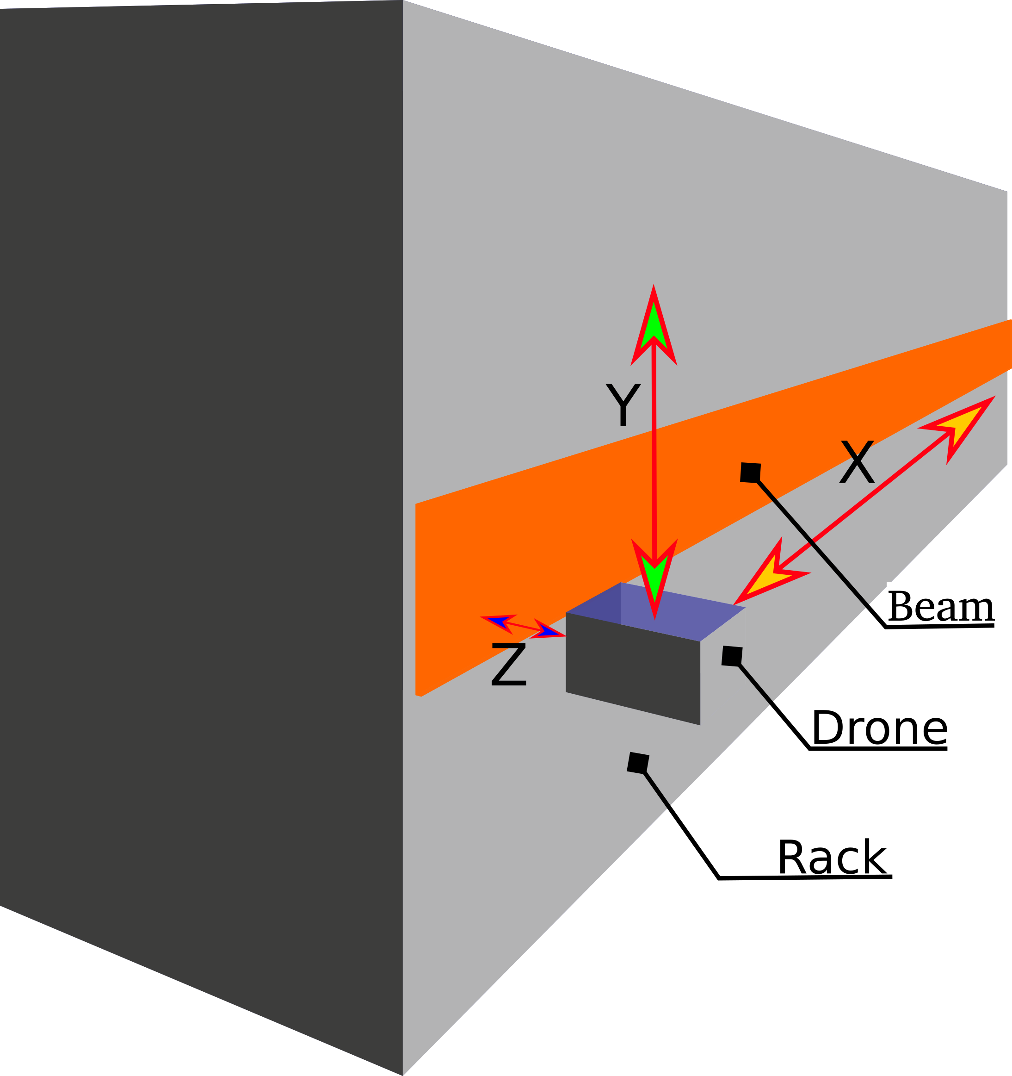
State Machine Concept
Point of no return
Smaller scope
Product over research

Slide 17
Correcting position
Collision avoidance
Correcting position
Advancing
Notes:
State machine works like this.
Explain the cycle step by step using next images

Slide 18
Vision Pipeline
Notes:
Quickly explain what happens at each picture
Mention color segmentation

Slide 19
Notes:
Mention distance and center offset

Slide 20
Collision Detection
Notes:
Explain pros and cons

Slide 21
Conclusion
Stand-alone RL insufficient
Optimization of vision
Continuation of approaches

